Slide 1
5 Keys to Disrupting Member Engagement
By Andy Steggles
andy@higherlogic.com

Slide 2
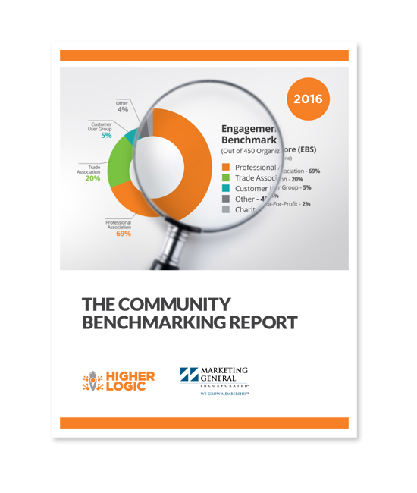

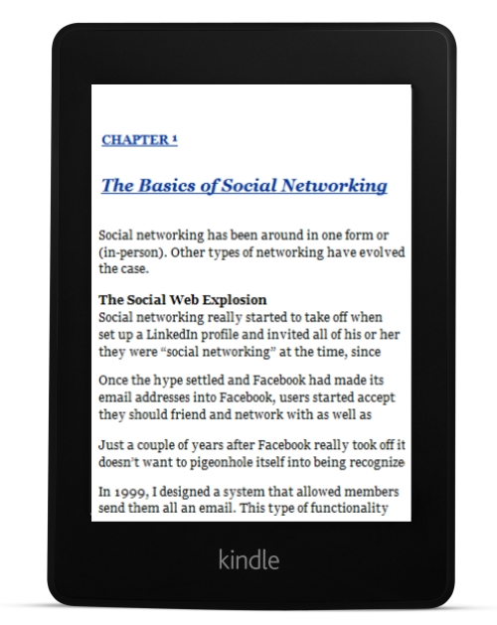
WELCOME!
Andy Steggles
President & Co-Founder
Higher Logic
Notes:
Andy and Tom do intros

Slide 3
What is Community?
Group of People with a Common Interest and a need to Engage
Community Types
Experts
Directories
Local (geographical) Groups (Chapters)
Conference/Meetings
Education
Volunteerism
Advocacy
Mentoring
Leadership
Specialty Groups
Notes:
Andy
service is information that is personal and relevant to you...

Slide 4
Benchmarking Goals:
Identify Best Practices for Engaging Members
Quantify Benchmarking Metrics for Different Sized Organizations
Identify Trending Over Time
Connect Engagement with Retention
Make Recommendations based on Findings
Demonstrate a Strong Correlation Between Engagement and Retention
Notes:
Perform Correlation Analysis
Compare with MGI MM Benchmark
3 Year Trending Analysis
200+ Engagement Variables (+Ratios Between Variables)
Create a Engagement Benchmark Score (EBS)

Slide 5
EBS by Quartile
Engagement Benchmark Score (EBS)

Slide 6
Year-over-Year EBS

Slide 7
Top 10 Average EBS by Industry

Slide 8
All Industries by EBS

Slide 9
EBS by Geographical Focus

Slide 10
Size of Org (Users) by Avg EBS

Slide 11
People vs. Content

Slide 12
Contributor Types by Category and Audience Penetration
Notes:
Engaged = the percentage of the total known audience that is either a creator or contributor

Slide 13
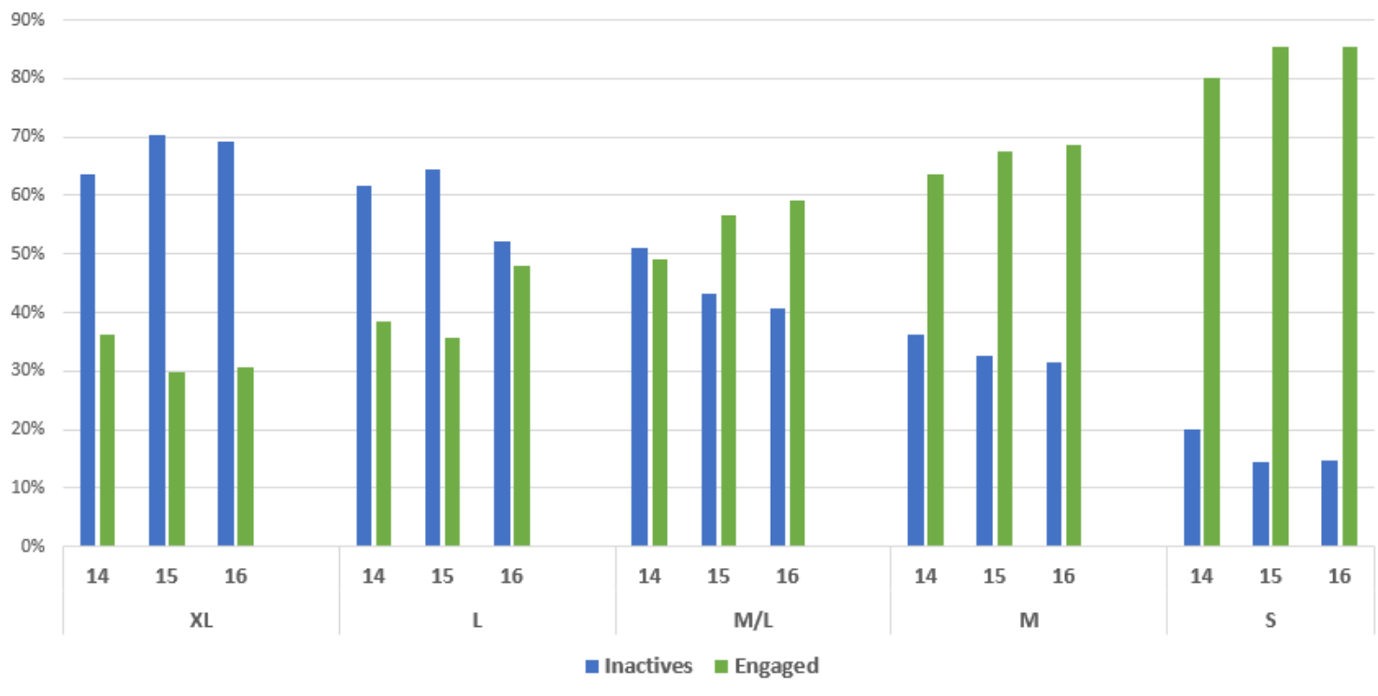
Audience Penetration
Notes:
Contributor Types by Category

Slide 14
Individual Engagement

Slide 15
NCACPA Avg Individual Engagement Score

Slide 16
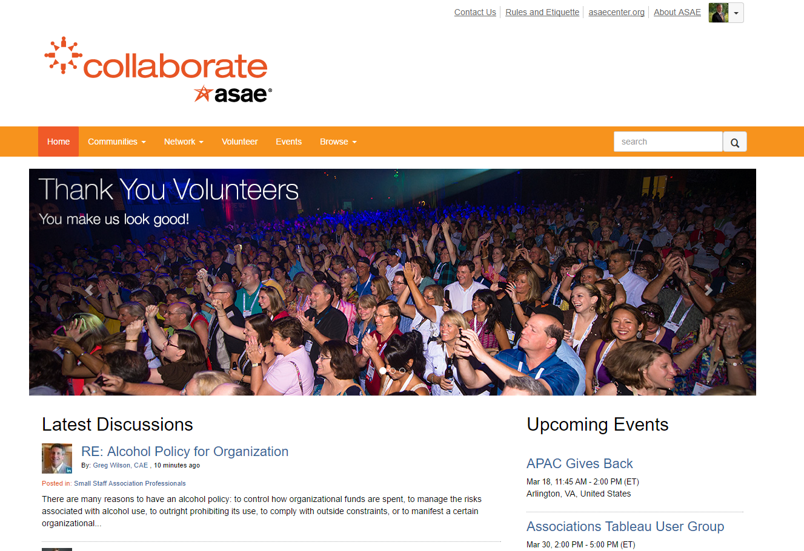
Community Examples:
Notes:
Andy

Slide 17
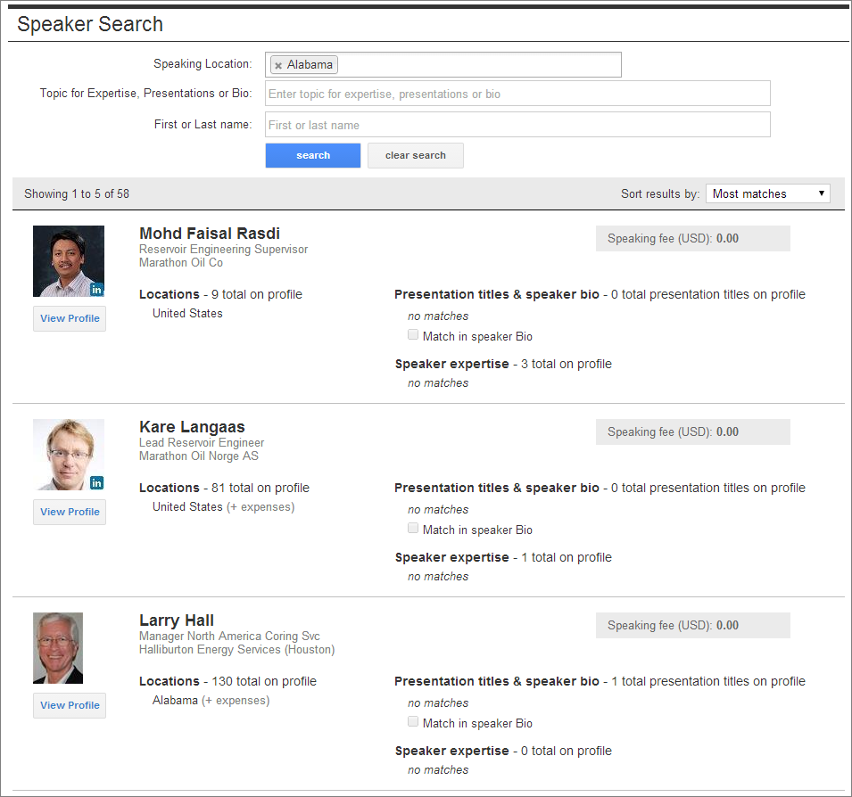
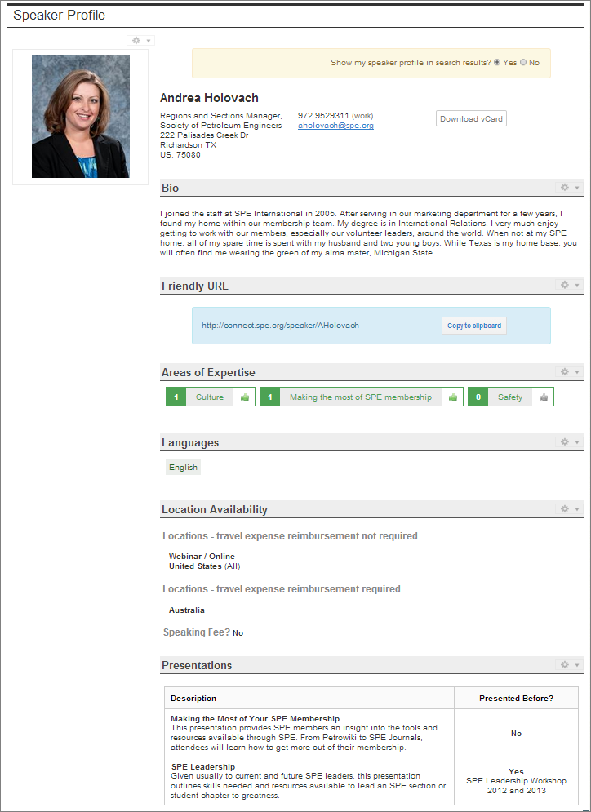
Expert/Speaker Community
Notes:
Andy

Slide 18
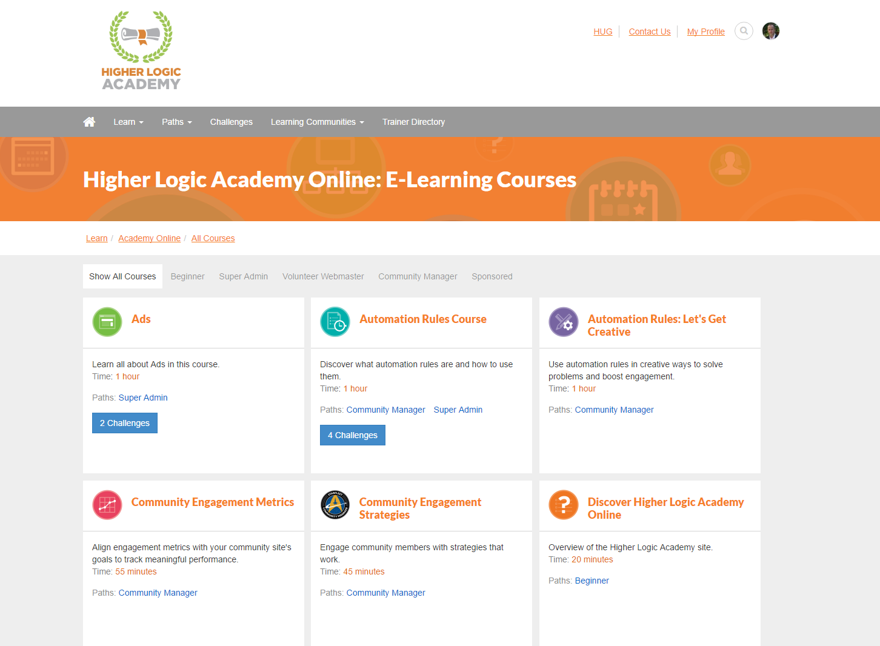
Learning Community
Notes:
Andy

Slide 19
Volunteerism and Automation
Micro-Volunteer Examples
Enables more members to become more engaged in a more meaningful way.
Correlates to improved retention, greater satisfaction and organizational value creation.

Slide 20
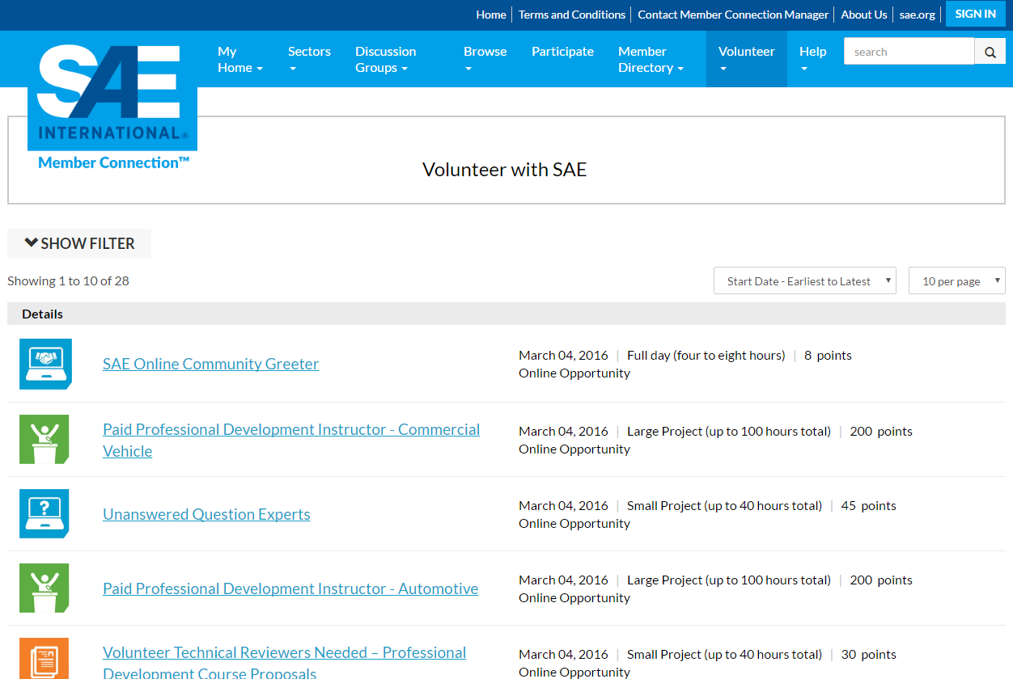
Re: http://connection.sae.org/volunteeropportunities/opportunities-list-public
Notes:
Andy

Slide 21
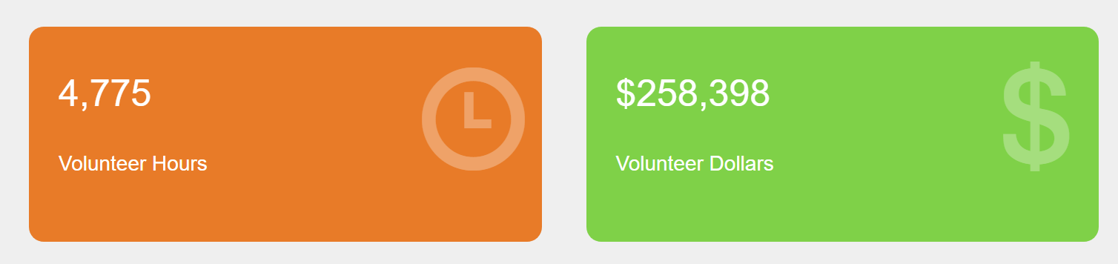
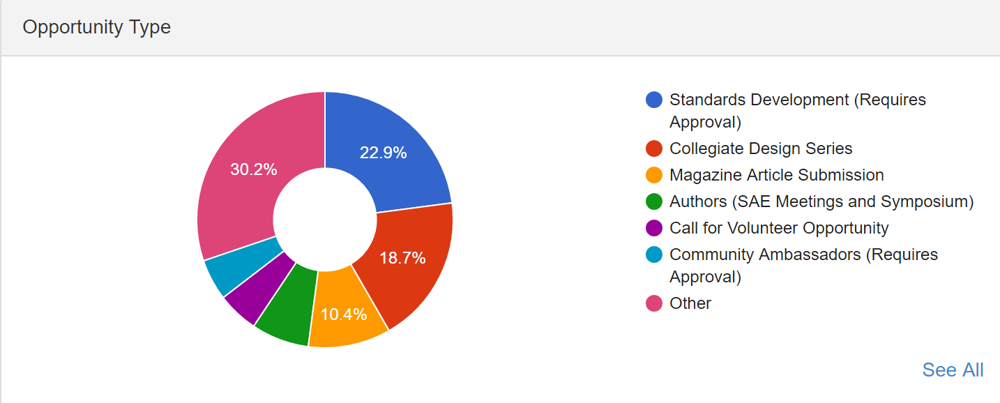
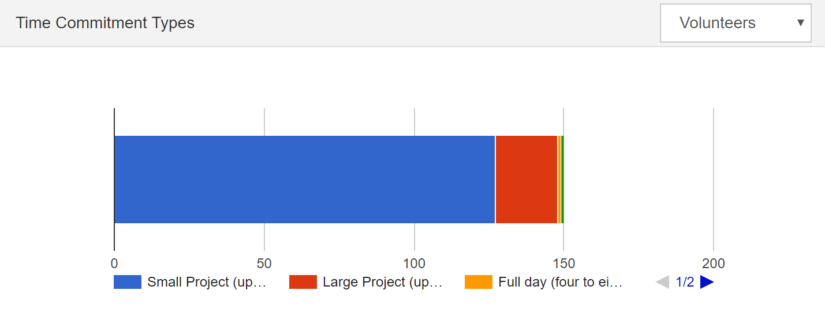
Measuring and Recognizing Volunteerism

Slide 22
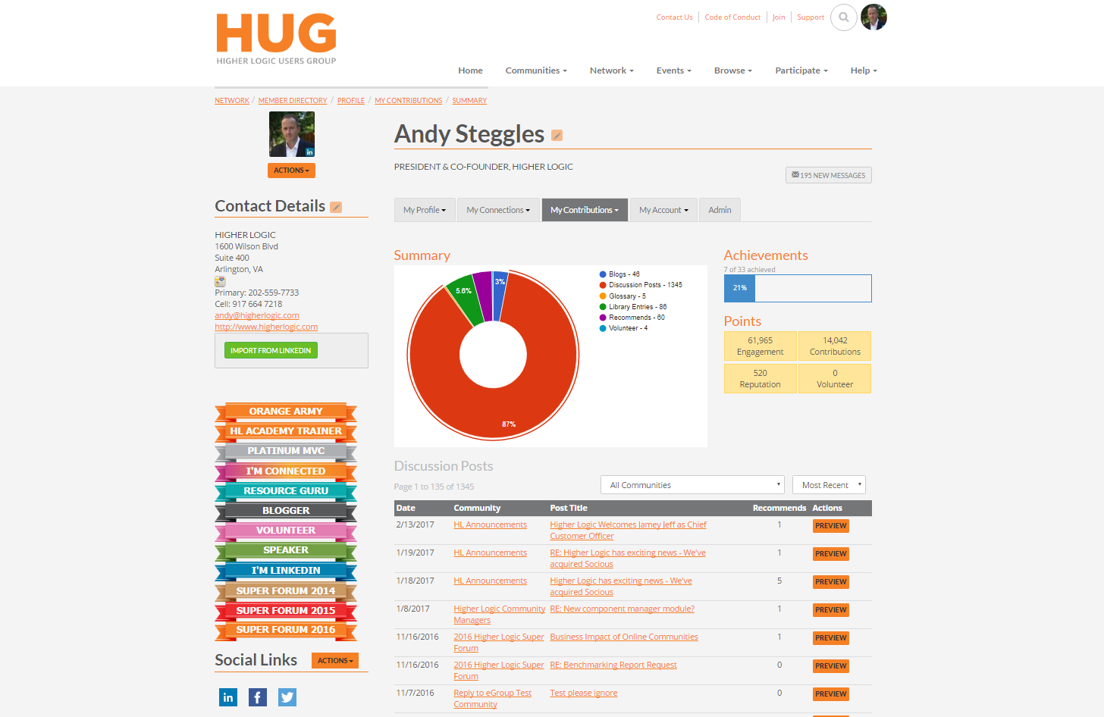

Slide 23
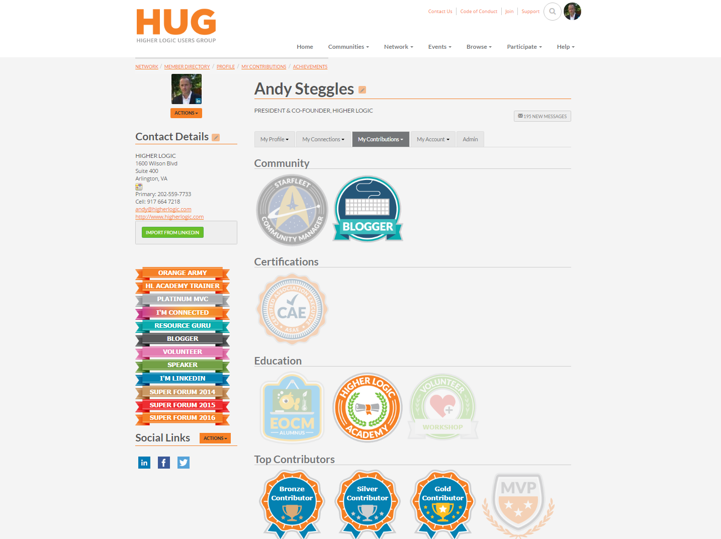

Slide 24
Member Service vs Marketing Automation
Member Service:
Messages are “Non-Marketing”
Contain an “Ask” or “Thank you”
Optimized by the use of Journey Mapping
Marketing:
Campaign Based, Action Focused, Graphically Rich etc

Slide 25
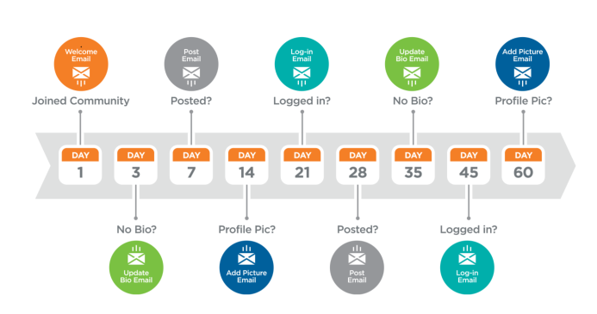
Journey Mapping
Journey: Onboarding by Persona (Primary Contact)

Slide 26
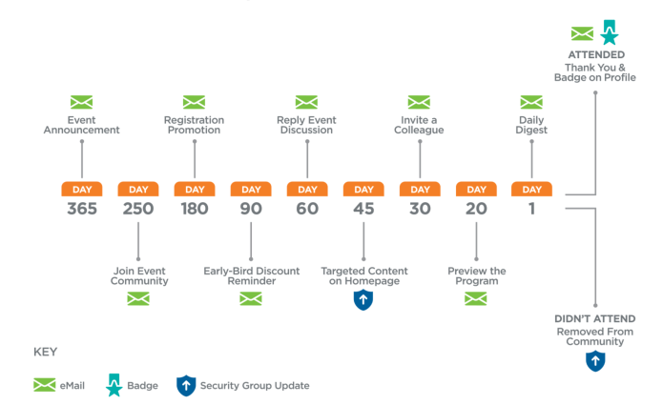
Journey: Annual Conference Attendee

Slide 27
Execution Strategy
Review Benchmarking Report:
  www.higherlogic.com/benchmarkreport
Choose your KPIs
Map Your Member Journey
Set Goals
Implement Automation
Measure Conversions

Slide 28
THANK YOU
Andy Steggles
President & Co-Founder
andy@higherlogic.com
@asteggles
Notes:
By Andy Steggles

